Slide 1
DataManager
Proctor Overview
Statewide Academic Achievement Test
English Learner Reclassification
for Grades 1, 2, 11, and 12
Notes:
Title: Texas English Learner Reclassification-- _DataManager: Set up and Test Administration
Thank you for joining this webinar to learn about the setup of the DataManager platform for the Texas Statewide Academic Achievement Test for English Learner Reclassification for Grades 1, 2, 11, and 12

Slide 2

Learning Objectives:
Overview
Iowa Assessments
Proctor Functions
Online Demonstration
Creating Test Sessions
Student Login & Testing Experience
Monitoring Students During Testing
Continuing or Ending Testing
Student Look-up
Notes:
Today we are going to give you an overview of the Iowa Assessment and the proctor functions. Then we will demonstrate what testing will look like from both the proctor standpoint and the student standpoint.

Slide 3



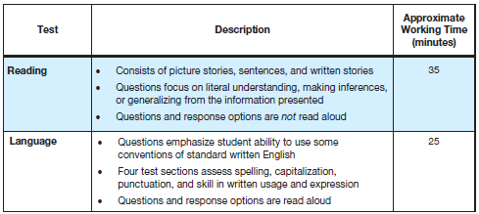
1st and 2nd Grade Iowa Survey
Survey:
  Abbreviated battery for Reading, Language, and Math
  Students are only required to take Reading & Language subtests
Refer to Directions for Administration
Notes:
Students in grades 1 and 2 will be assigned to take the Iowa Survey, which is an abbreviated battery for Reading, Language and Math. For Reclassification testing, the 1st and 2nd grade students will only be taking the Reading and Language subtests of the Iowa Survey, not the math

Slide 4
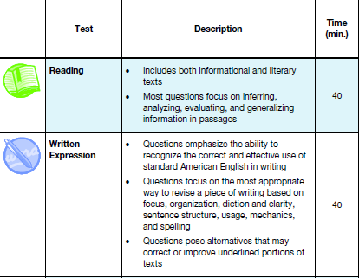

11th and 12th Grade Iowa Complete
Complete:
  All content areas including Reading, Language, Math, Science and Social Studies
  Students are only required to take Reading & Written Expression
Refer to Directions for Administration
Notes:
Students in grades 11 and 12 will be assigned to take the Iowa Complete but for Reclassification testing, 11th and 12th grade students will only be taking the Reading and Written Expression subtests, Each of these subtest are timed for 40 min

Slide 5
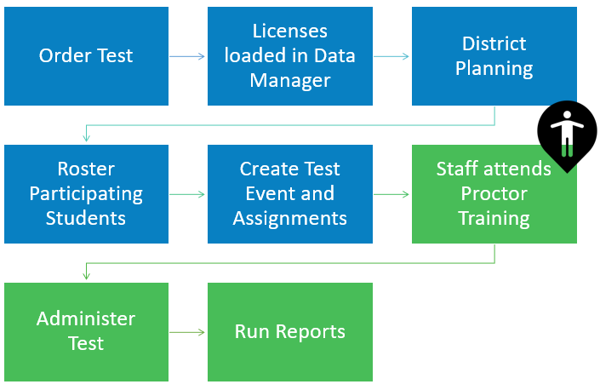
Online Testing Setup:
Tasks completed by Account Holder
Notes:
“Before we start looking at the tasks that you will do as a proctor, let me tell you about some of the things that your main DataManager Administrator, who we refer to as the “Account Holder”, has done to begin the process.
First,’ the account holder will have uploaded files into DataManager – they will have entered in the staff who will use DataManager .. And they will have entered in names of all of the students who will be testing. So you don’t need to enter your students into DataManager – they are already there!
Next, the account holder will have created what we call the Test Event for the district which defines who will test, when everyone will test and the norms that will be applied to all who test within that window.
Next the account holder assigned the students who are testing to the level of test that they will take … Grade 1 has been assigned level 7, grade 2 level 8 and grades 11 and 12 level 17/18.
Let’s look at the tasks you will need to do to proctor the test!

Slide 6
Proctor Functions - IOWA
Grades 11 and 12
Create Test Sessions
Approve students for testing
Students will independently read samples and directions (Self-Paced)
Monitor students during testing Pause/Resume Terminate
Grades 1 and 2
Create Test Sessions
Approve students for testing
Audio Session: System provides instructions via headset | Proctor led session: Proctor provides directions/instructions during test session
Monitor students during testing Pause/Resume Terminate
OR
Notes:
As a proctor, you will have several tasks to do ..
You will need to create tests sessions. After test events have been created and test assignments have been made, the DataManager™ Proctor application is used to create and manage online test sessions. When students test, they must be associated with a test sessions. These sessions can be administered at any time within the test event time frame.
2. You will also approve students for testing.
Students in grades 11 and 12 will read through all sample items and test questions through 2 timed subtests – this is refereed to as a ‘self paced’ test as students will read through all directions and test items on their own. For grades 1 and 2, the test is not timed; in addition, there are directions/instructions that the students will receive through the sample items as well as test items. There are 2 ways the students can receive these instructions: one is for the system to provide instructions which the students will hear through headphones OR the proctor can read directions orally from a script which will be on the proctor screen.
4. You will also monitor students during testing.

Slide 7
Test
Event
Test
Assignments
Test
Sessions
DataManager Online Testing
1 Event for the Entire District
Grades & Test Levels
Students Test in Sessions
Notes:
For our training today, we will begin with the next task that must be completed – and that is to create Test Sessions … when students test, they must be associated with a test session … today we will cover how to create test sessions and then how those sessions are used for student testing.

Slide 8

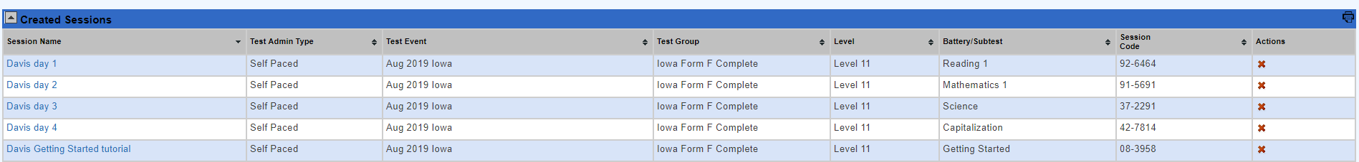
DataManager Test Sessions
Created by Administrators or Proctors
Created in advance or on the spot
Proctors do not have to add students to sessions
      Individual Student
      Small Group
      Large Group
Notes:
Test sessions can be created by Administrators or Proctors
They can be created in advance or on the spot
As a Proctor, you will not have to add students to sessions as students will be added into DataManager by the account holder for your district.

Slide 9

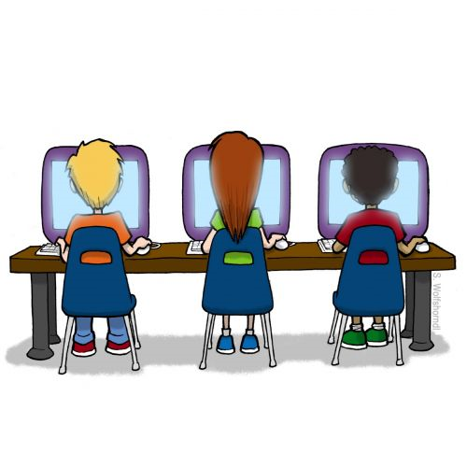

Test Sessions
Notes:
When testing, a proctor or teacher will login to the DataManager site and open the session, then monitor the students from DataManager the entire time students are testing. CLICK Students will join on the devices you have prepared through either the secure browser or Data Manager app. I will log into the system shortly to show you both the proctor experience and student testing experience.

Slide 10
Online Testing Schedule and Test Progression
How will the test be administered?
Both subtests on same day?
One subtest on one day and the 2nd subtest on a different day?
Testing schedule impacts and correlates with the creation of Test Sessions
Notes:
Consideration will need to be given as to how your will administer the test … whether both subtests will be given to students in 1 sitting or whether the students take the reading subtest on one day and Language (grades 1 and 2) or written expression (grades 11 and 12) on a different day?

Slide 11
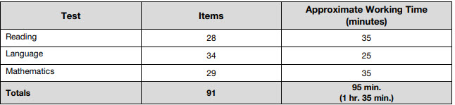
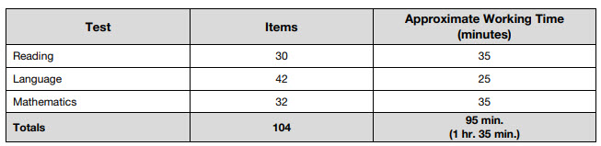
Levels 7 and 8: approximate test times
Grade 1/ level 7
Grade 2/ level 8
Notes:
As you plan for your testing schedule, consider the approximate time needed for the 2 subtests for grades 1 and 2

Slide 12
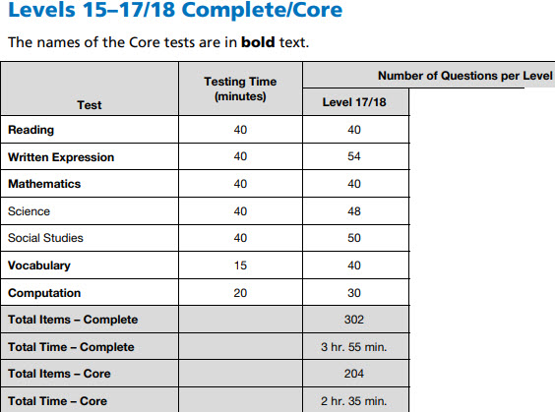
Levels 17/18: test times
Notes:
The 2 subtests for grades 11 and 12 are timed – so you will need to determine if you have time to give both subtests in 1 sitting or if you need to give 1 subtest on one day and the other subtest on a different day.

Slide 13
Testing Scenario Example:
Test in 1 Day
Grades 1 and 2
Grades 11 and 12
Create Test Sessions for each class/group for each day of testing:
Getting Started (Suggested)
Reading
        Use Continue Testing All Button
    Language/Written Expression
        Use End Testing All Button
Notes:
If administering both subtests in 1 sitting, you will just need to create 1 test session per group and grade. Once all students in the session complete the reading subtest, the proctor will be able to move the students to the next subtest by selecting the option “continue testing all”.

Slide 14
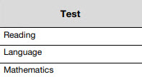
For grades 1 and 2: To move students from Reading subtest to the Language subtest
Continue Testing All
End Testing All
Notes:
The proctor has to move the student (as a group) from 1 subtest to the next – you will be able to do this with a button that says “continue testing all” . When all 1st and 2nd grade students in the session complete the Reading subtest , to move students to the Language subtest, the proctor will click a button that says ‘continue testing all’.
When students complete the Language subtest, the proctor will end testing by clicking “end testing all”

Slide 15
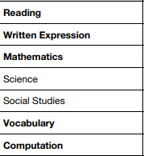
For grades 11 and 12: To move students from Reading subtest to the Written Expression subtest:
Continue Testing All
End Testing All
Notes:
The same thing applies to grades 11 and 12. When all students in the session complete the Reading subtest, to move to Written Expression the proctor will click ‘continue testing all’ and when all student complete Written Expression , the proctor will select “end testing all”
I will show you this ‘live’ in a few minutes.

Slide 16

Continue Testing All
1st Subtest: Reading
2nd Subtest: Language (Gr 1 and 2) or Written Expression (Gr 11and 12)
Continue Testing All
End Testing All
16
Notes:
On the 1st day of administering the test: give the students the Test Session code to connect students to the 1st subtest. (CLICK)
(CLICK) When all students in the session complete the 1st subtest, (CLICK) the proctor can click “continue testing all” which will move (CLICK) all students to the 2nd subtest.
(CLICK) When all students complete the 2nd subtest, the Proctor can select (CLICK) “End Testing All”
(CLICK) Students’ devices will be returned to the Login Screen. If testing is completed for the day, to return to the active desktop (laptops and desktops only) students or staff must select “CTRL + SHIFT + Q” For iPads and Chromebooks, students only need to close the DataManager App.

Slide 17
Best Practices Using “Continue Testing All”
Students move together as a group using the “Continue Testing All” button.
“Continue Testing All” button moves students sequentially to the next subtest.
Minimizes the need to log in and out of the system after each subtest.
Notes:
Proctor can only move students together as a group using the “Continue Testing All” button. All Students’ status must say “Complete” before Proctor will have access to the “Continue Testing” button to move students to the next subtest.
Minimizes the need to log students in and out of the system after each subtest,.

Slide 18
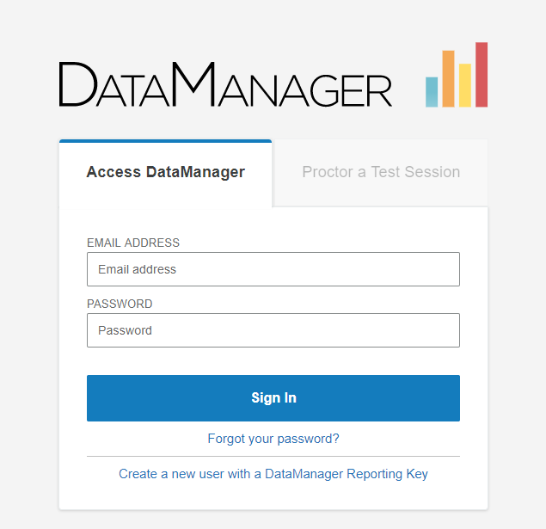
Proctor Access:
Wired Desktop or laptop computer
Browsers
  Explorer
  Edge
  Chrome
  Firefox
  Safari
www.riversidedatamanager.com
Notes:
Staff, including proctors, can access DM from a desktop or laptop and going to http://riversidedatamanager.com.

Slide 19
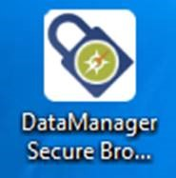
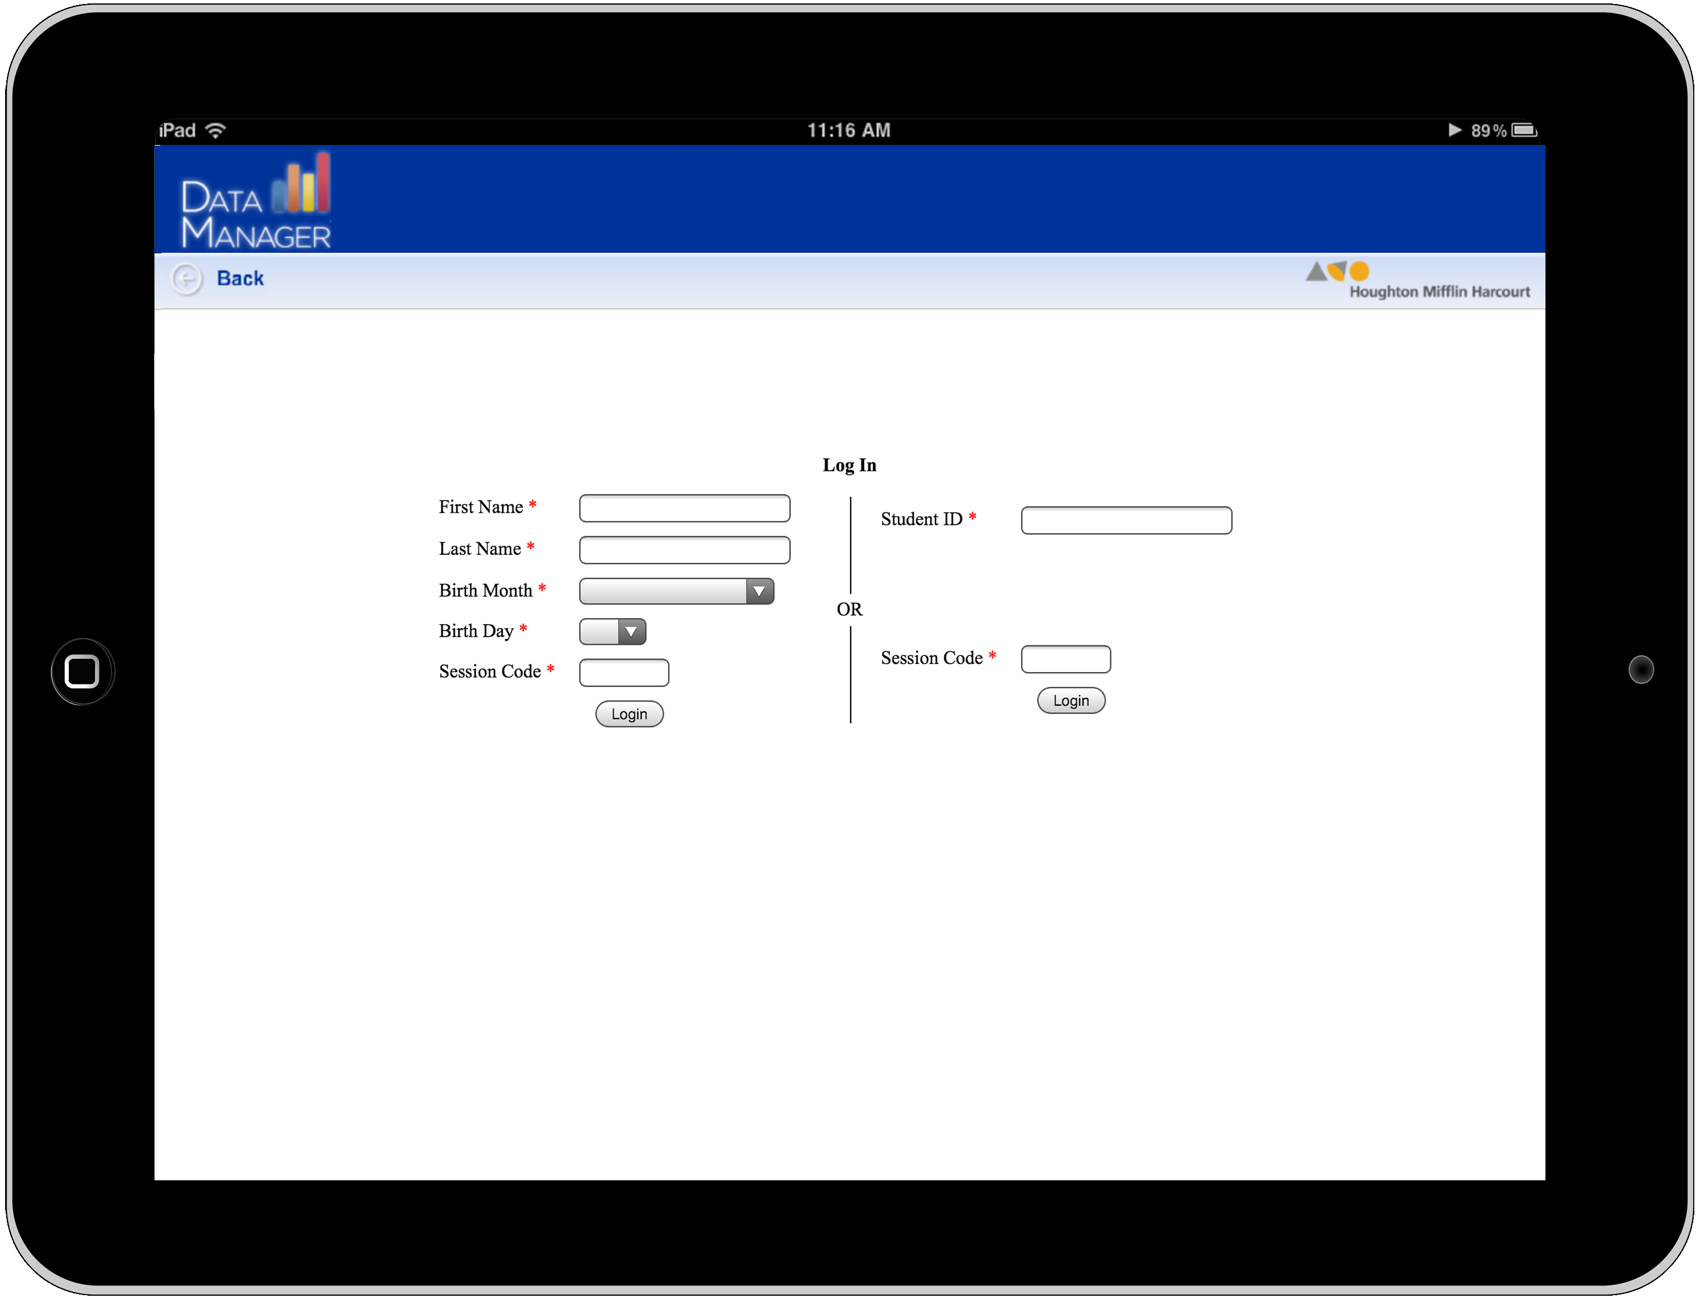
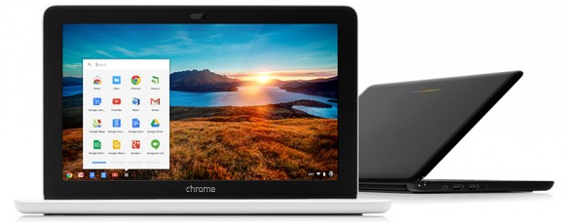
Student Access - 3 options:
Secure browser installed on desktop or laptop computer
App downloaded on iPad
App downloaded on Chromebook
Notes:
Students can access the online test in one of 3 options: a secure browser from a desktop/laptop, from an app installed on a Chromebook, from an app installed on iPad

Slide 20
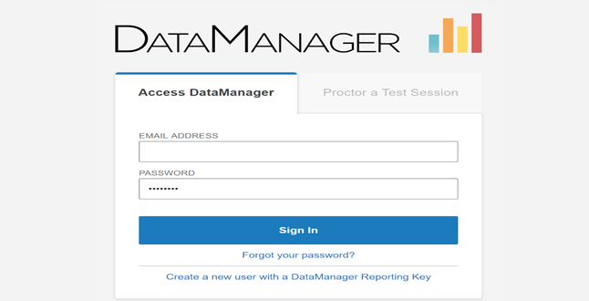
  www.riversidedatamanager.com
Notes:
I am now going to log into DataManager and demonstrate how to create test sessions, how to open the session and what testing will look like for both the student and the proctor.
***You will now be live in DM …. Remaining slides are for SCRIPT when navigating live in DM

Slide 21
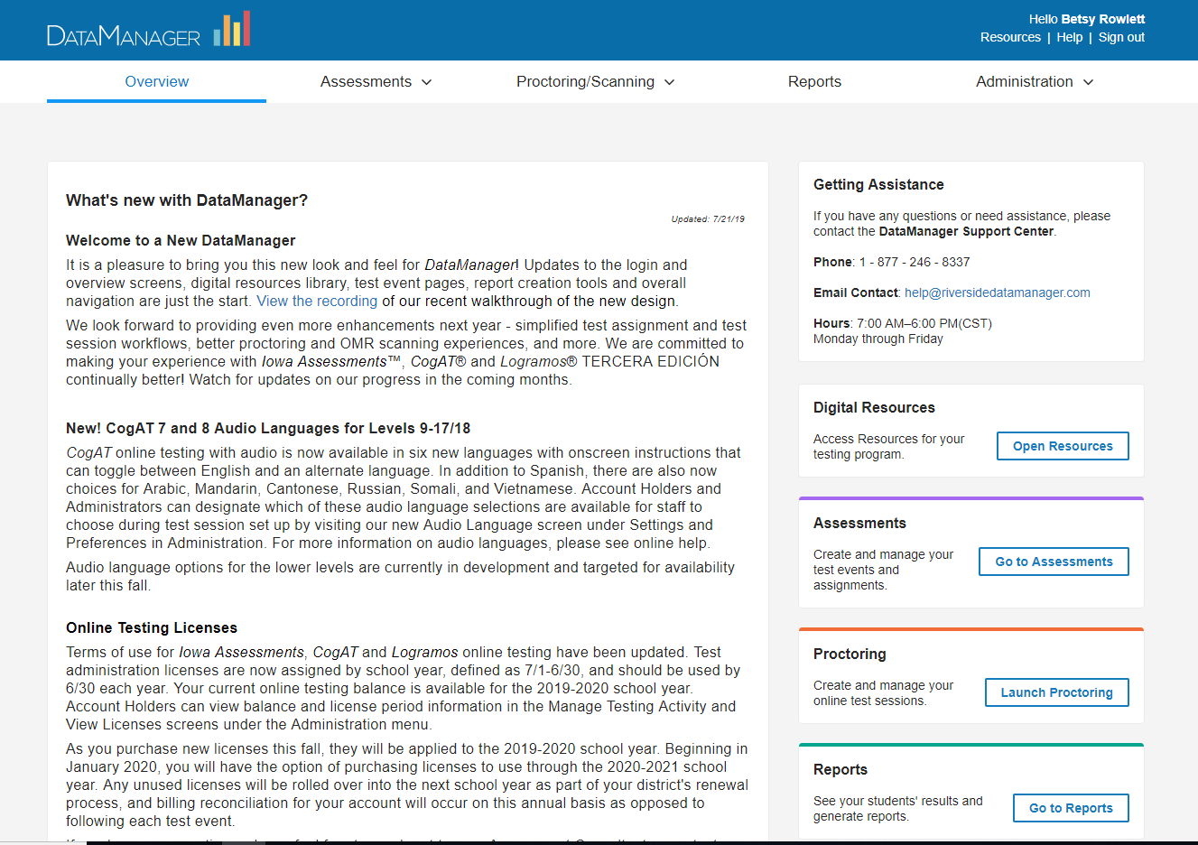
Notes:
Once logged in you are at the Overview page where you will see announcements and options to navigate to other areas of DataManager-- Overview, Assessments, proctoring, Reports, Administration

Slide 22
Overview area
Notes:
First, from the overview area, you can access a number of useful resources from the Digital Resources link from the left menu
Here you will see a library of resources for the Iowa Test, for the CogAT , for DataManager.
You will find resources such as: Directions for Online Administration, Practice Activities, DataManager User’s Guides, and the Score Interpretation Guides.

Slide 23
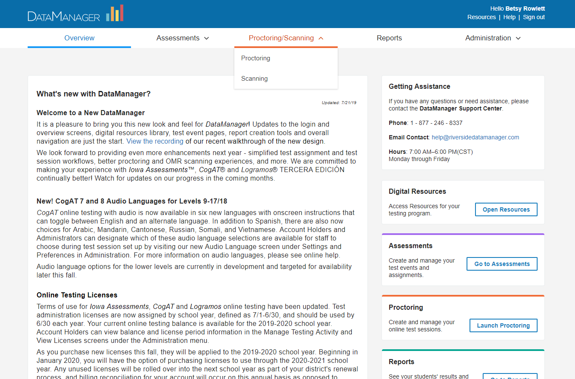
To access the proctor area:
Notes:
To access the proctor area, from toolbar, select Proctoring

Slide 24
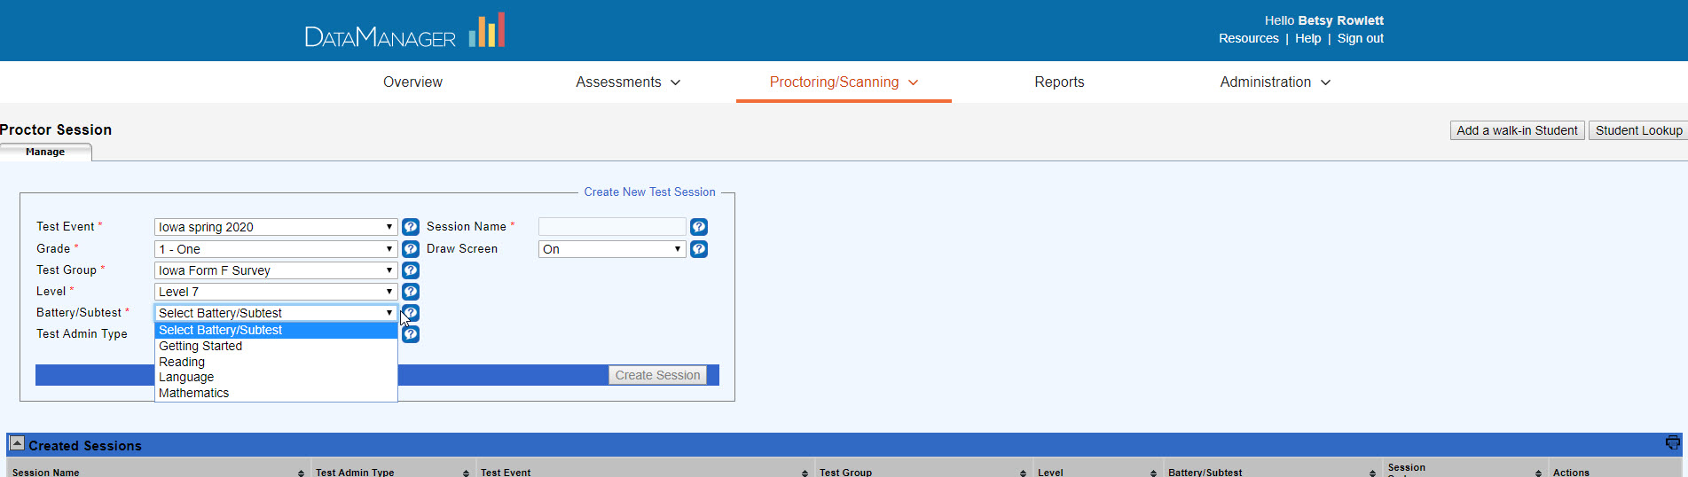
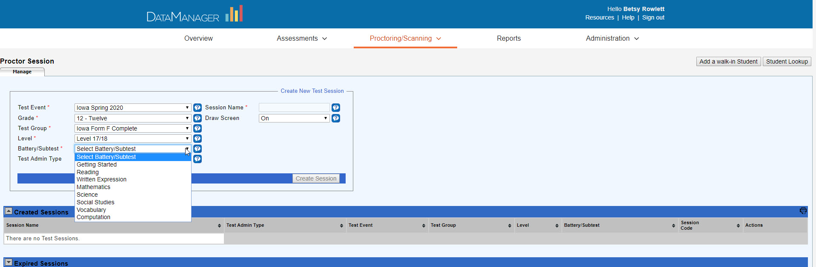
Notes:
From the proctor screen, test sessions are created (top half of the screen) and (bottom half of the screen) created test sessions are opened to begin testing.
Let’s begin by looking at how you create a test session:
Test Event: Select “Reclassification”
Grade: Select the appropriate grade
Test Group: Select default
Level: Select default
Battery/Subtest: Select “Reading”
Test Admin Type: for Grades 1 and 2, select “Audio-English” or “Proctor Led”; for Grades 11 and 12 select the default option of “Self-Paced”
Session Name: Example: teacher name, grade, battery such as Grade1_Martinez_Reading
Draw Screen: Optional (district choice)
Click Create Session
Once the test session is created, you will locate the session and session code from the list of Created Sessions; this session code needs to be provided to students for testing.

Slide 25
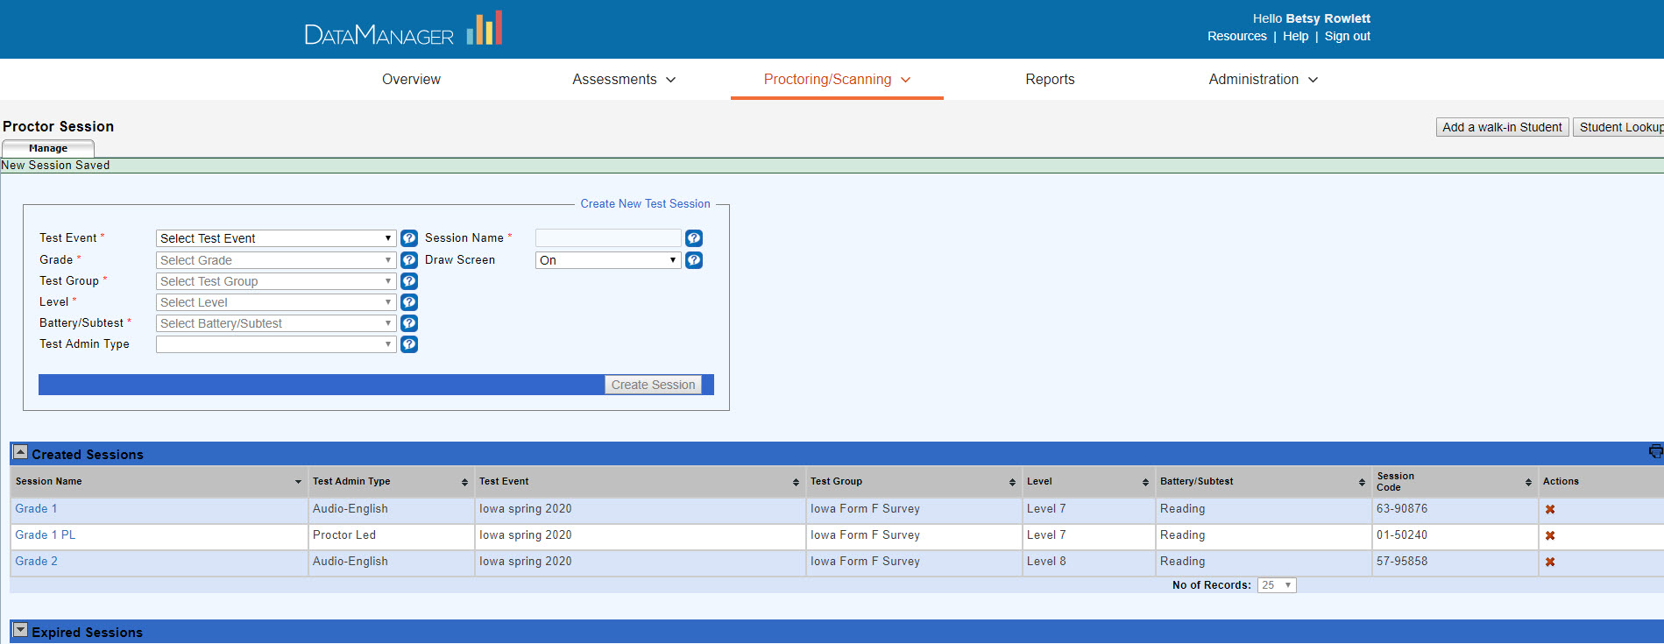
Notes:
Once test sessions have been created, students will use the test session code to access their online test.
When it is time to test the students, the proctor will open up the test session by clicking on the test session name.

Slide 26
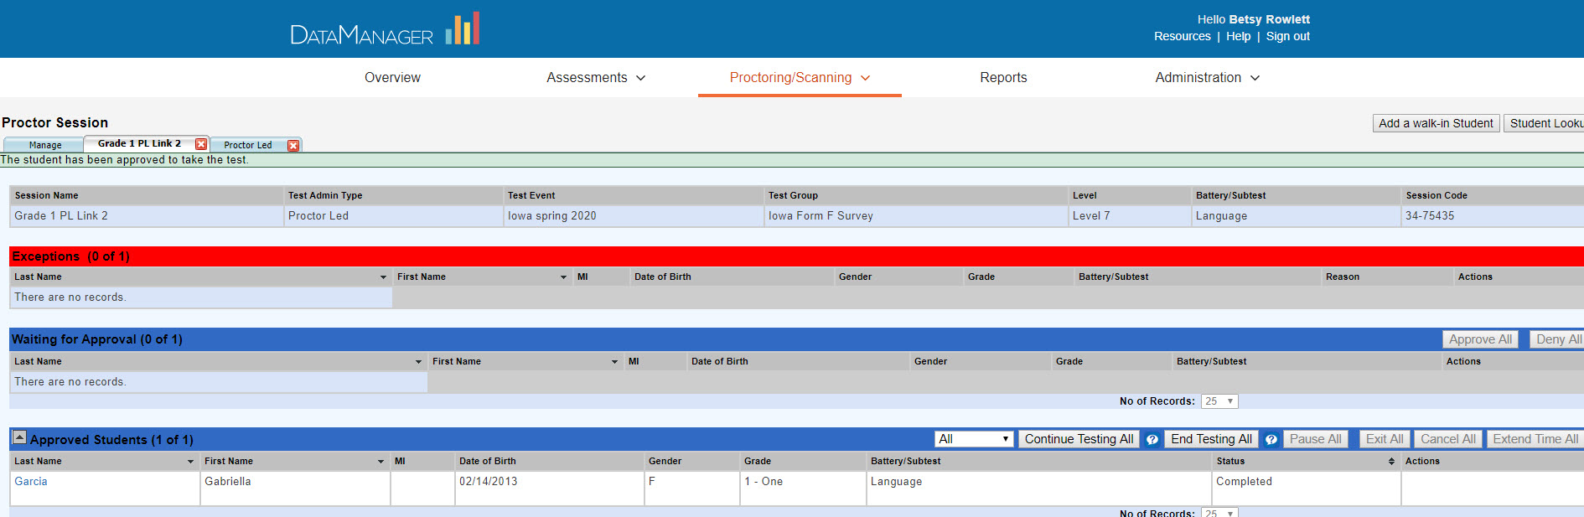
Starting the test for Students
Notes:
For grades 11 and 12 and for audio session for grades 1 and 2, ONE new tab will open
For grades 1 and 2, if the session was set up as Proctor Led, when the proctor clicks on the name of a proctor led session 2 new tabs will open -- the first will have the name of the session on the tab (known as the “session tab”); the 2nd will say “Proctor led”.
From the session tab (tab with the name of the session), the proctor will watch for students to log in.

Slide 27
Notes:
Students will launch the secure browser that has been installed on the desktop of the computer that they are using for testing or will click on the app from their iPad or Chromebook

Slide 28
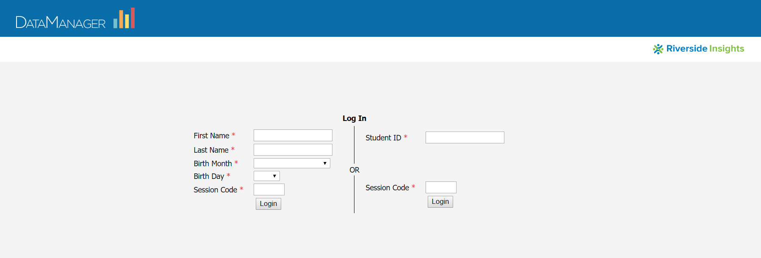
Student Log-In Options
Notes:
Students have 2 options for logging in – from the left side of the screen they can enter the required information, including the test session code.
Or, from the right side of the screen, the students can enter their student ID and the session code.

Slide 29
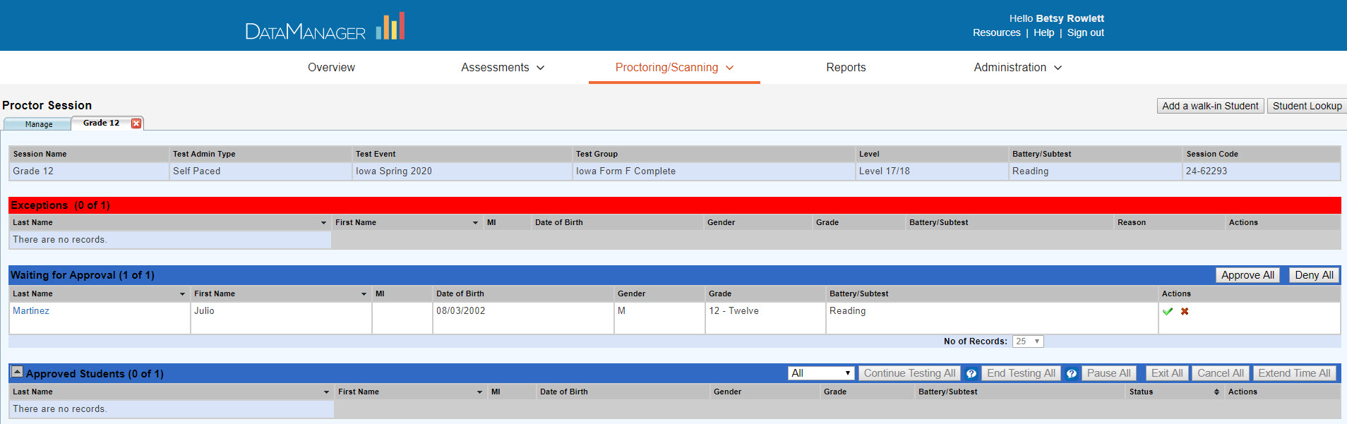
Student Log-In: Waiting for Approval
Notes:
As students log in, the proctor will see the students’ names appear in the Waiting for Approval area.

Slide 30
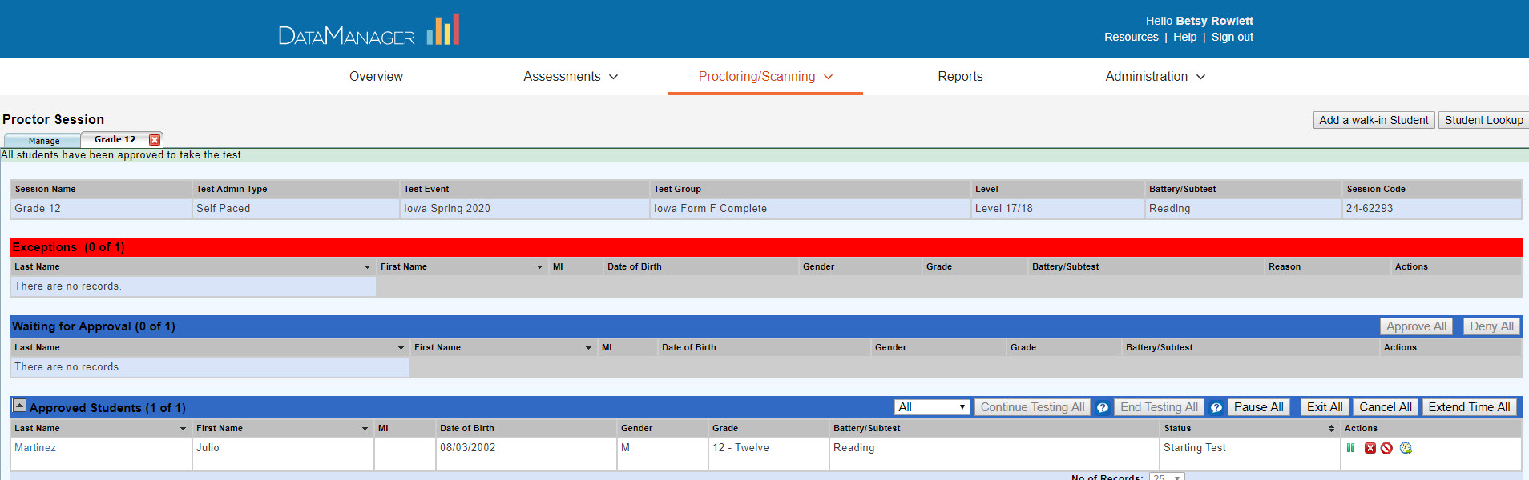
Notes:
Once all students have logged in, the proctor will click Approve All and all students' names will move to the Approved Students area.

Slide 31
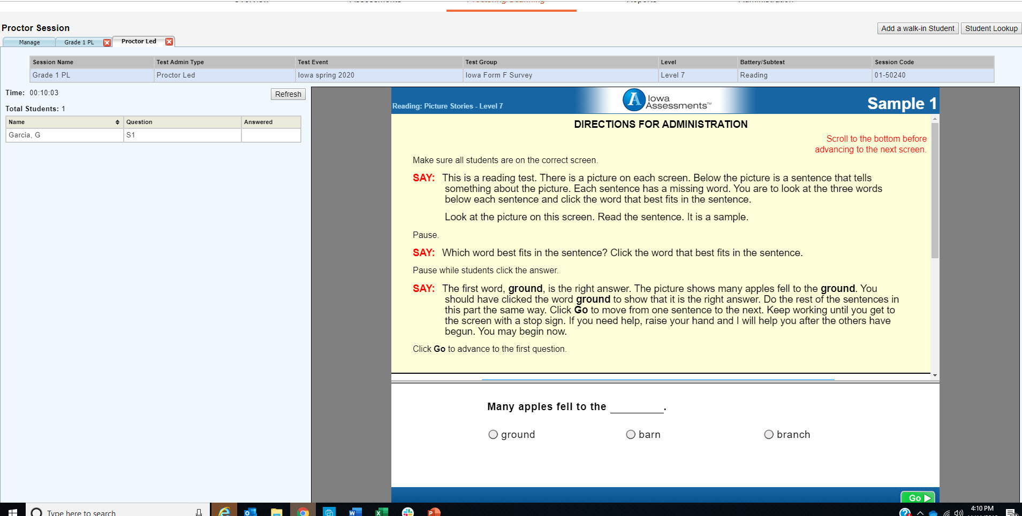
Providing Directions
Notes:
Once students have been approved for testing, if the proctor is orally giving the directions to the students in grades 1 and 2 (a proctor led session), the proctor will move to the “proctor led” tab.
From the Proctor Led tab, the proctor will find the directions for test administration.
From the table on the left, the proctor will see the list of students who are in the session … and will be able to see where each student is in the test.
The main area of the screen will have the directions for the proctor to administer.

Slide 32
Notes:
The proctor must read the directions verbatim as written on the screen.
The proctor must move the students through the sample items. When the proctor clicks “go”, all students in the session move to the next screen / next sample item.

Slide 33
Notes:
For students in grades 11 and 12 or for stusetns in grades 1 or 2 who are in an audio session, the students will navigate through the subtest using the Next or Go button on the student test screen

Slide 34
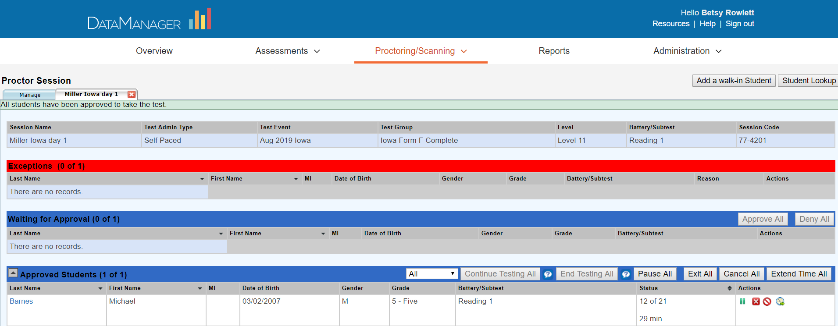
Notes:
Whether testing students in grade 1, 2, 11, or 12, the proctor will be able to monitor the students during testing from the sessions tab (tab with session name on it).
In addition, the proctor has the ability to pause the test for the students, save and exit the test, cancel the test, or add time to the test for students (individually or for the group).

Slide 35
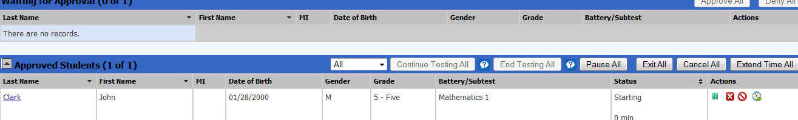

Notes:
There are several functions that the proctor can use with individual students or with all students in the session:
Pause /Pause All: this will pause the test for the student or for the group for a few minutes. Best Test practice: have students go to the restroom, get water, etc. before the subtest begins.
Exit:/ Exit All closes the test and saves what the student or all students in the session have completed so far – this would allow the student to resume the test later. (Best Test Practice: the student should complete the entire subtest in one sitting.)
Cancel/Cancel ALL: closes the test and does NOT save anything for the student (this basically allows the student to start over) Caution: if the student is allowed to start over, they have now had exposure to test questions that other students have not
Extend Time (Grades 11 and 12 only): allows time to be added to the individual student’s subtest. Recommendation: follow district policy about adding time

Slide 36
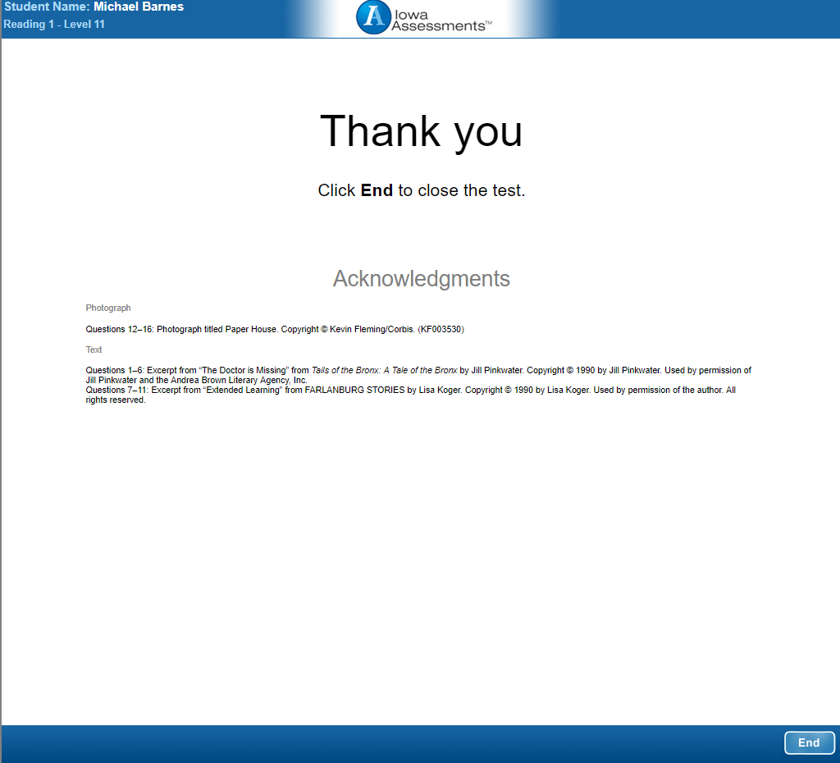
Notes:
Once the student reaches the end of the subtest, for the subtest to be marked as “completed”, the student must click to End the test. If the student does not click to End the test, the proctor will not be able to continue testing or end testing.
Once all students have completed the subtest, the proctor has the option to continue testing to the next subtest or to end testing.

Slide 37
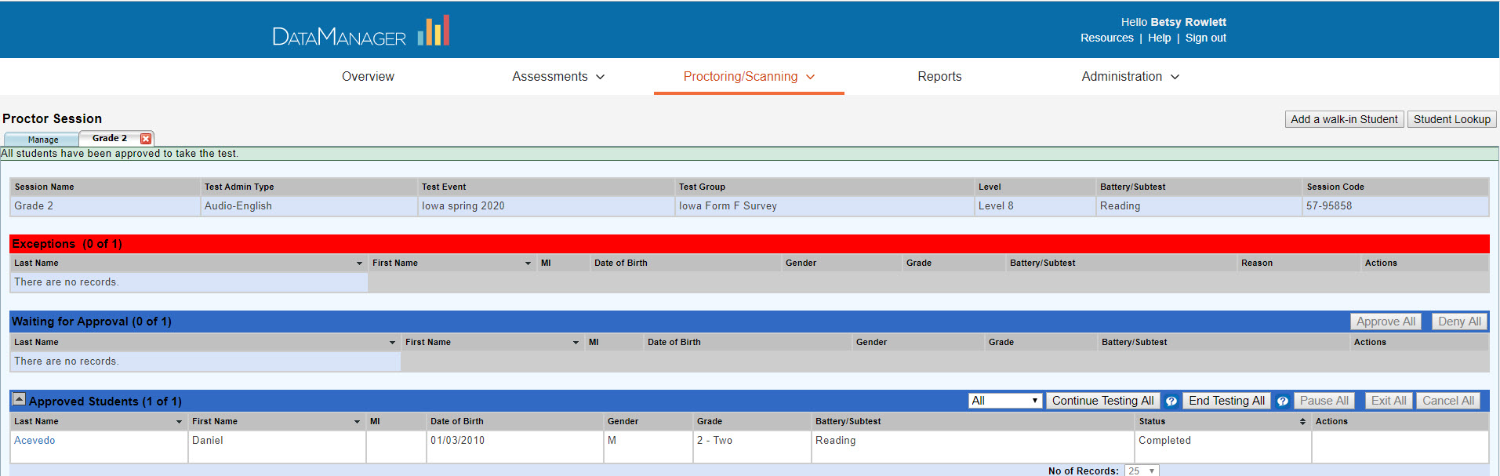
Notes:
The Continue Testing All and End Testing All buttons become active when all students in the session have a status of Completed. (And the test only shows as completed when the student has clicked to End the test)
Selecting Continue Testing All will move all students in the session to the next subtest which is Written Language for Grades 11 and 12 and Language for Grades 1 and 2. The 2nd subtest will begin (if the session is Proctor led for grades 1 and 2, the proctor will move back to the “proctor led tab” to give directions for the Language subtest.
If the proctor selects to end testing, the students will be logged out. A new test session will need to be created so that the students can continue testing with the next subtest.

Slide 38
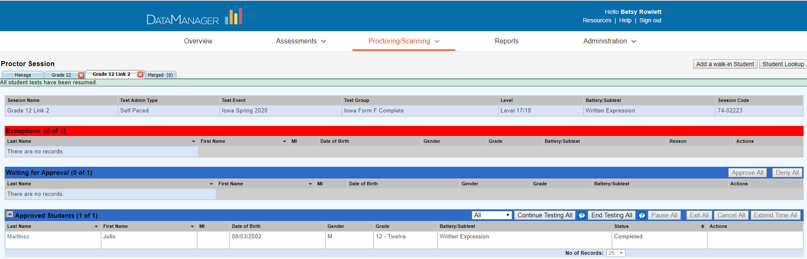
When students complete the 2nd subtest, select End Testing
Notes:
When all students in the session complete the 2nd subtest, CLICK the proctor will click on End Testing All which will end testing and log all students out of DataManager

Slide 39
Student Lookup
Notes:
Let’s look at a few additional features that you will be able to do:
From the proctor screen, you can look up student information – to find student names, student IDs, and to see what subtests the student(s) have or haven't completed.

Slide 40
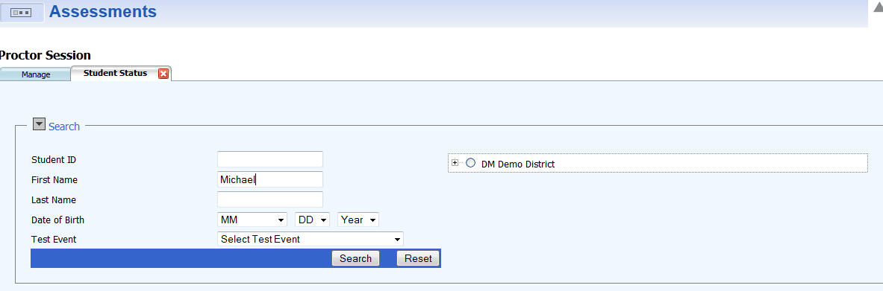
Notes:
Click on the Student Lookup button to open up the lookup feature.
You can look up students by name or you can look up an entire class.
To look up by student, type in some information on the student (first name or last name or student ID, etc) and then click Search

Slide 41
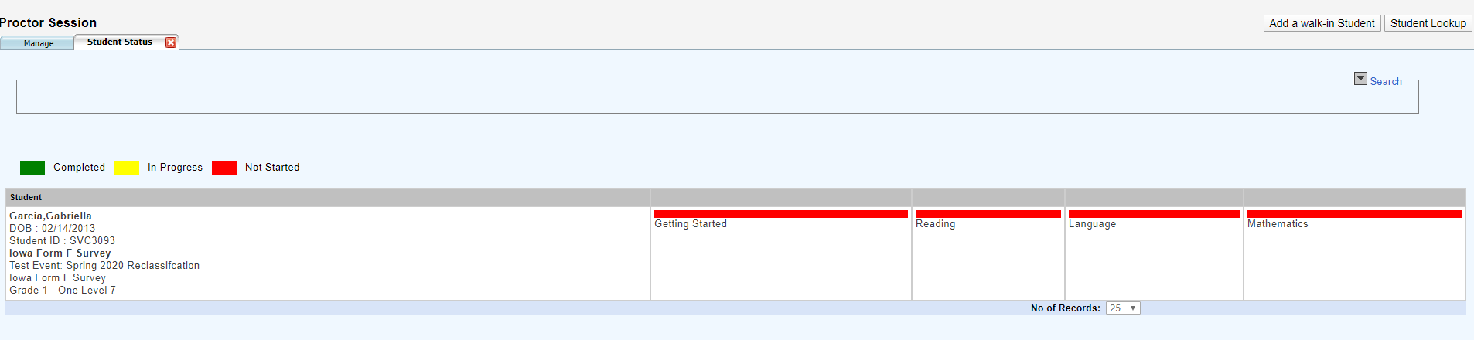
Notes:
You will see info on the student on the left (name, student ID, test to which the student is assigned) and the on the right you will see each subtest and be able to see which subtests the student has completed (shown in green), not started (shown in red) or if the student is currently testing, the subtest will be shown in yellow.

Slide 42
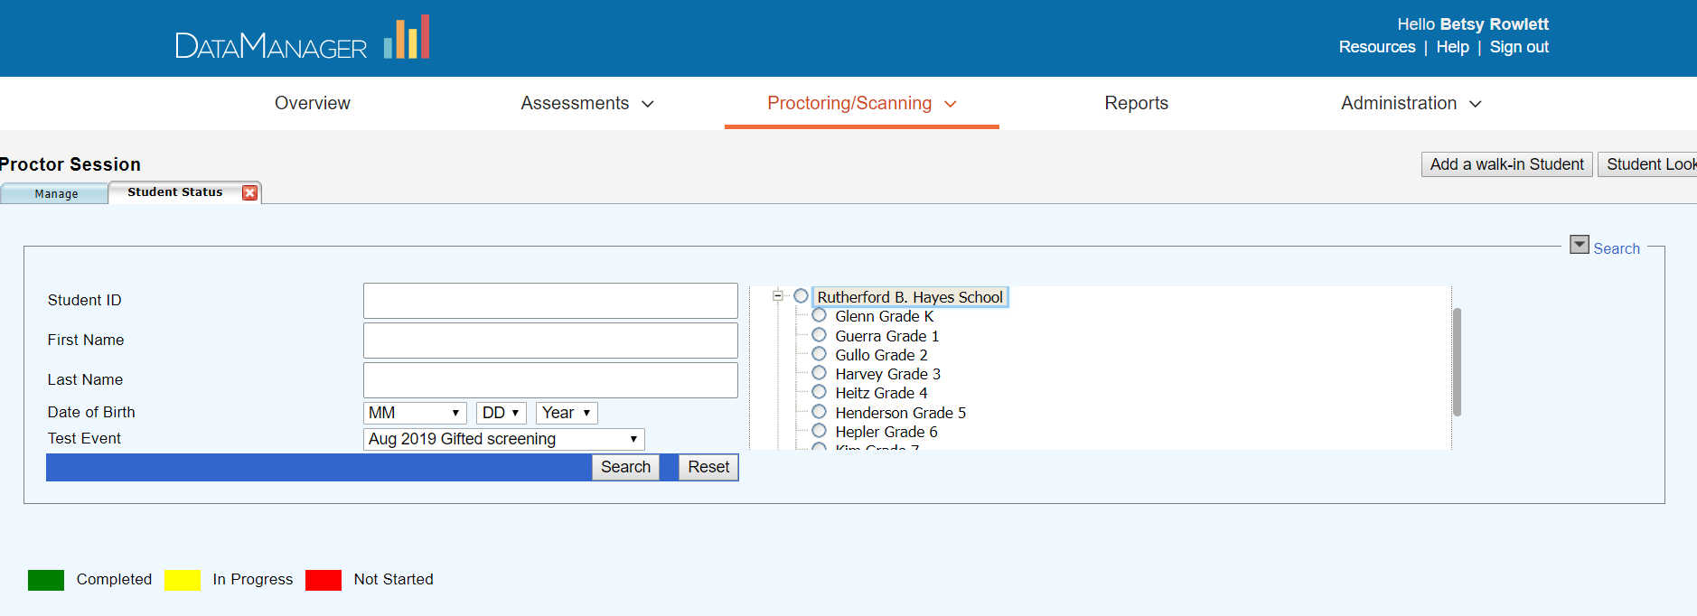
Notes:
You can also look up information on a class. From the hierarchy on the right, open up the hierarchy, and select the class, for example, for which you want to look up students – and then click Search.

Slide 43
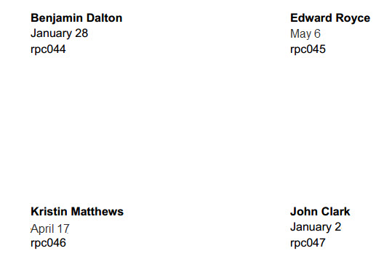
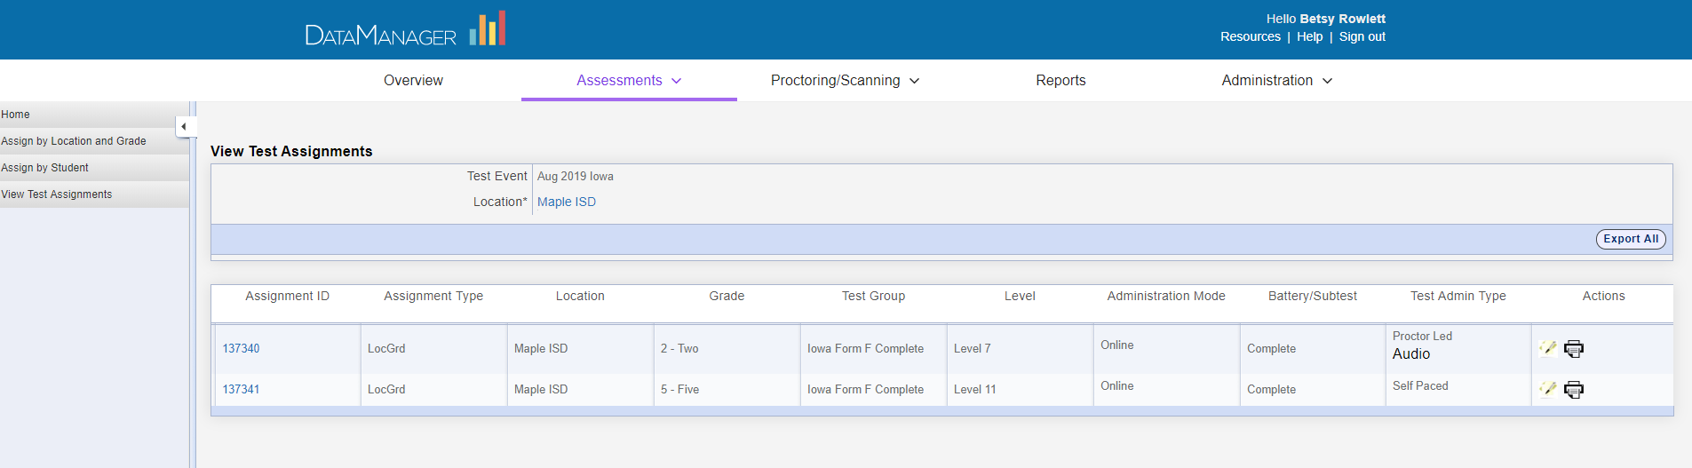
To print Student Log-in information:
Select Assessments and then Test Events
Select Assign (left of Test Event name)
From menu on left, select View Test Assignments
Click on the printer icon to the right of the grade assignment
First and Last Name
Birth month and day
Student ID
Notes:
You can also print out student log in information if needed:
Printing Student Log in info:
To print student log-in information:
Once logged in, from the application switcher, select Assessments.
Next, find the Test Event –
From here you can view the test assignment and print student login information
Select the orange icon beside the test event name.
Select how many to print on a page 8 or 30
This will provide the students with their first and last name, CLICK their birth month and day CLICK and their student ID

Slide 44
Learning Objectives:
Overview
Iowa Assessments
Proctor Functions
Online Demonstration
Creating Test Sessions
Student Login & Testing Experience
Monitoring Students During Testing
Continuing or Ending Testing
Student Look-up
Notes:
We have reviewed the proctor functions and also went through the process of creating test sessions, opening up a test session to begin testing and what online testing looks like from both the proctor and the student perspective

Slide 45
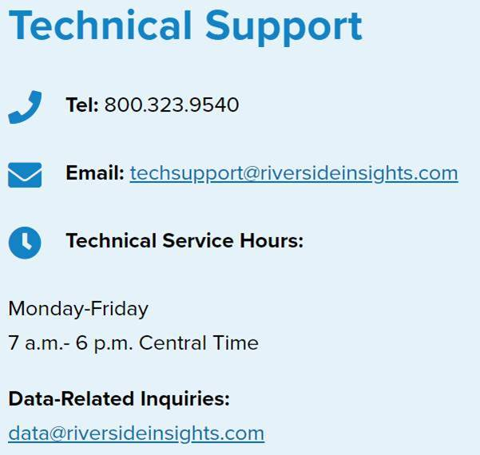
Support
Notes:
I will be following up with an email that will contain my contact info, any follow-up documents, and the technical support info you see on the screen. This team is available from 7-6 CST to answer your on the spot questions.

